Slide 1






SolarInSight
Mapping the Path to Renewable Success in Germany’s Photovoltaic Landscape.

Slide 2
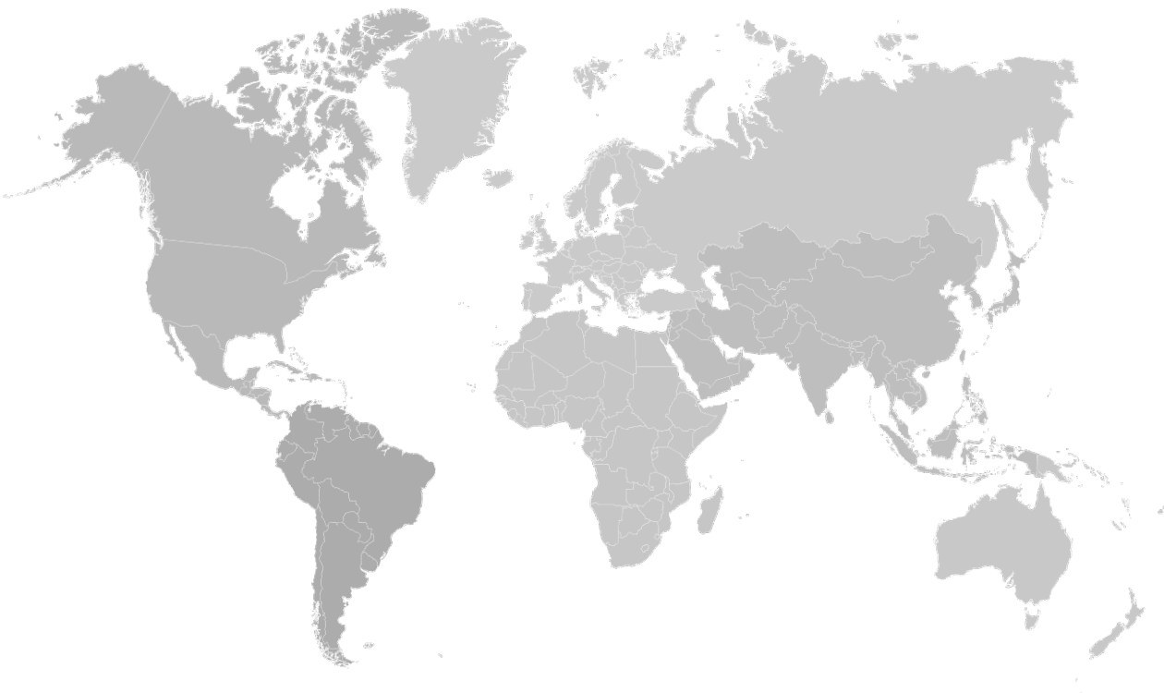









The Company: Google
A Worldwide Operating Company & Market Leader...
...and an “AI first“ approach.
...with a diverse product portfolio...

Slide 3



Case Description
Support the transition of renewable energies in Germany:
Understand overall challenges when it comes to the adoption and increase of photovoltaic energy sources in Germany.
Leverage data about solar capacity of buildings, mix it with other technical and economic data sources and address the identified challenges.
Combine the different data sources and conduct a dashboard or pitch, filled with data and insights to support the transition of renewable energies in Germany.

Slide 4





The Data
Electricity Prices
Weather
Project Sunroof
Electricity Consumption
Feed-in Tariffs
Hourly Day-Ahead auction prices since 2006.
Hourly values of temperature, humidity, wind speed, visibility for ca. 190 weather stations across Germany.
Solar capacity of buildings and their suitability for photovoltaic (PV) installations.
1. Census data: Data of the number of different houshold sizes per 100m grid in Germany
2. Electricity consumption data of households of approx. 2 years from Konstanz.
Monthly feed-in tariff since 2019.

Slide 5
Our Approach
Electricity Prices
Weather
Sunroof PV Capacity
Feed-in tariffs
Electricity
Consump-
tion & Census
Forecasting
Forecasting
Simulation
Average Value
Forecast hourly prices
Prediction
hourly
production
Simulation
hourly
consumption
Energy savings
Over-production savings
Financial and Energy Savings

Slide 6



Methods
We employed a variety of techniques to arrive at our ultimate outcome.
ARIMA models for time series forecasting of weather characteristics and electricity spot market prices. Forecast of 10000 future hours (approx. one year).
Neural Networks as well as Gradient Boosting and Random forest combinend in a stacked ensemble to predict PV Production with forecasted weather characteristics.
Simulation with a gaussian kernel density estimation of the hourly electricity consumption data to determine the conditional probability distribution fit. By means of that we are simulating the hourly electricity load of the different household sizes for each postal code.
We have further made use of different Google Cloud Platform techniques like BigQuery Machine Learning and geospatial algorithms.

Slide 7

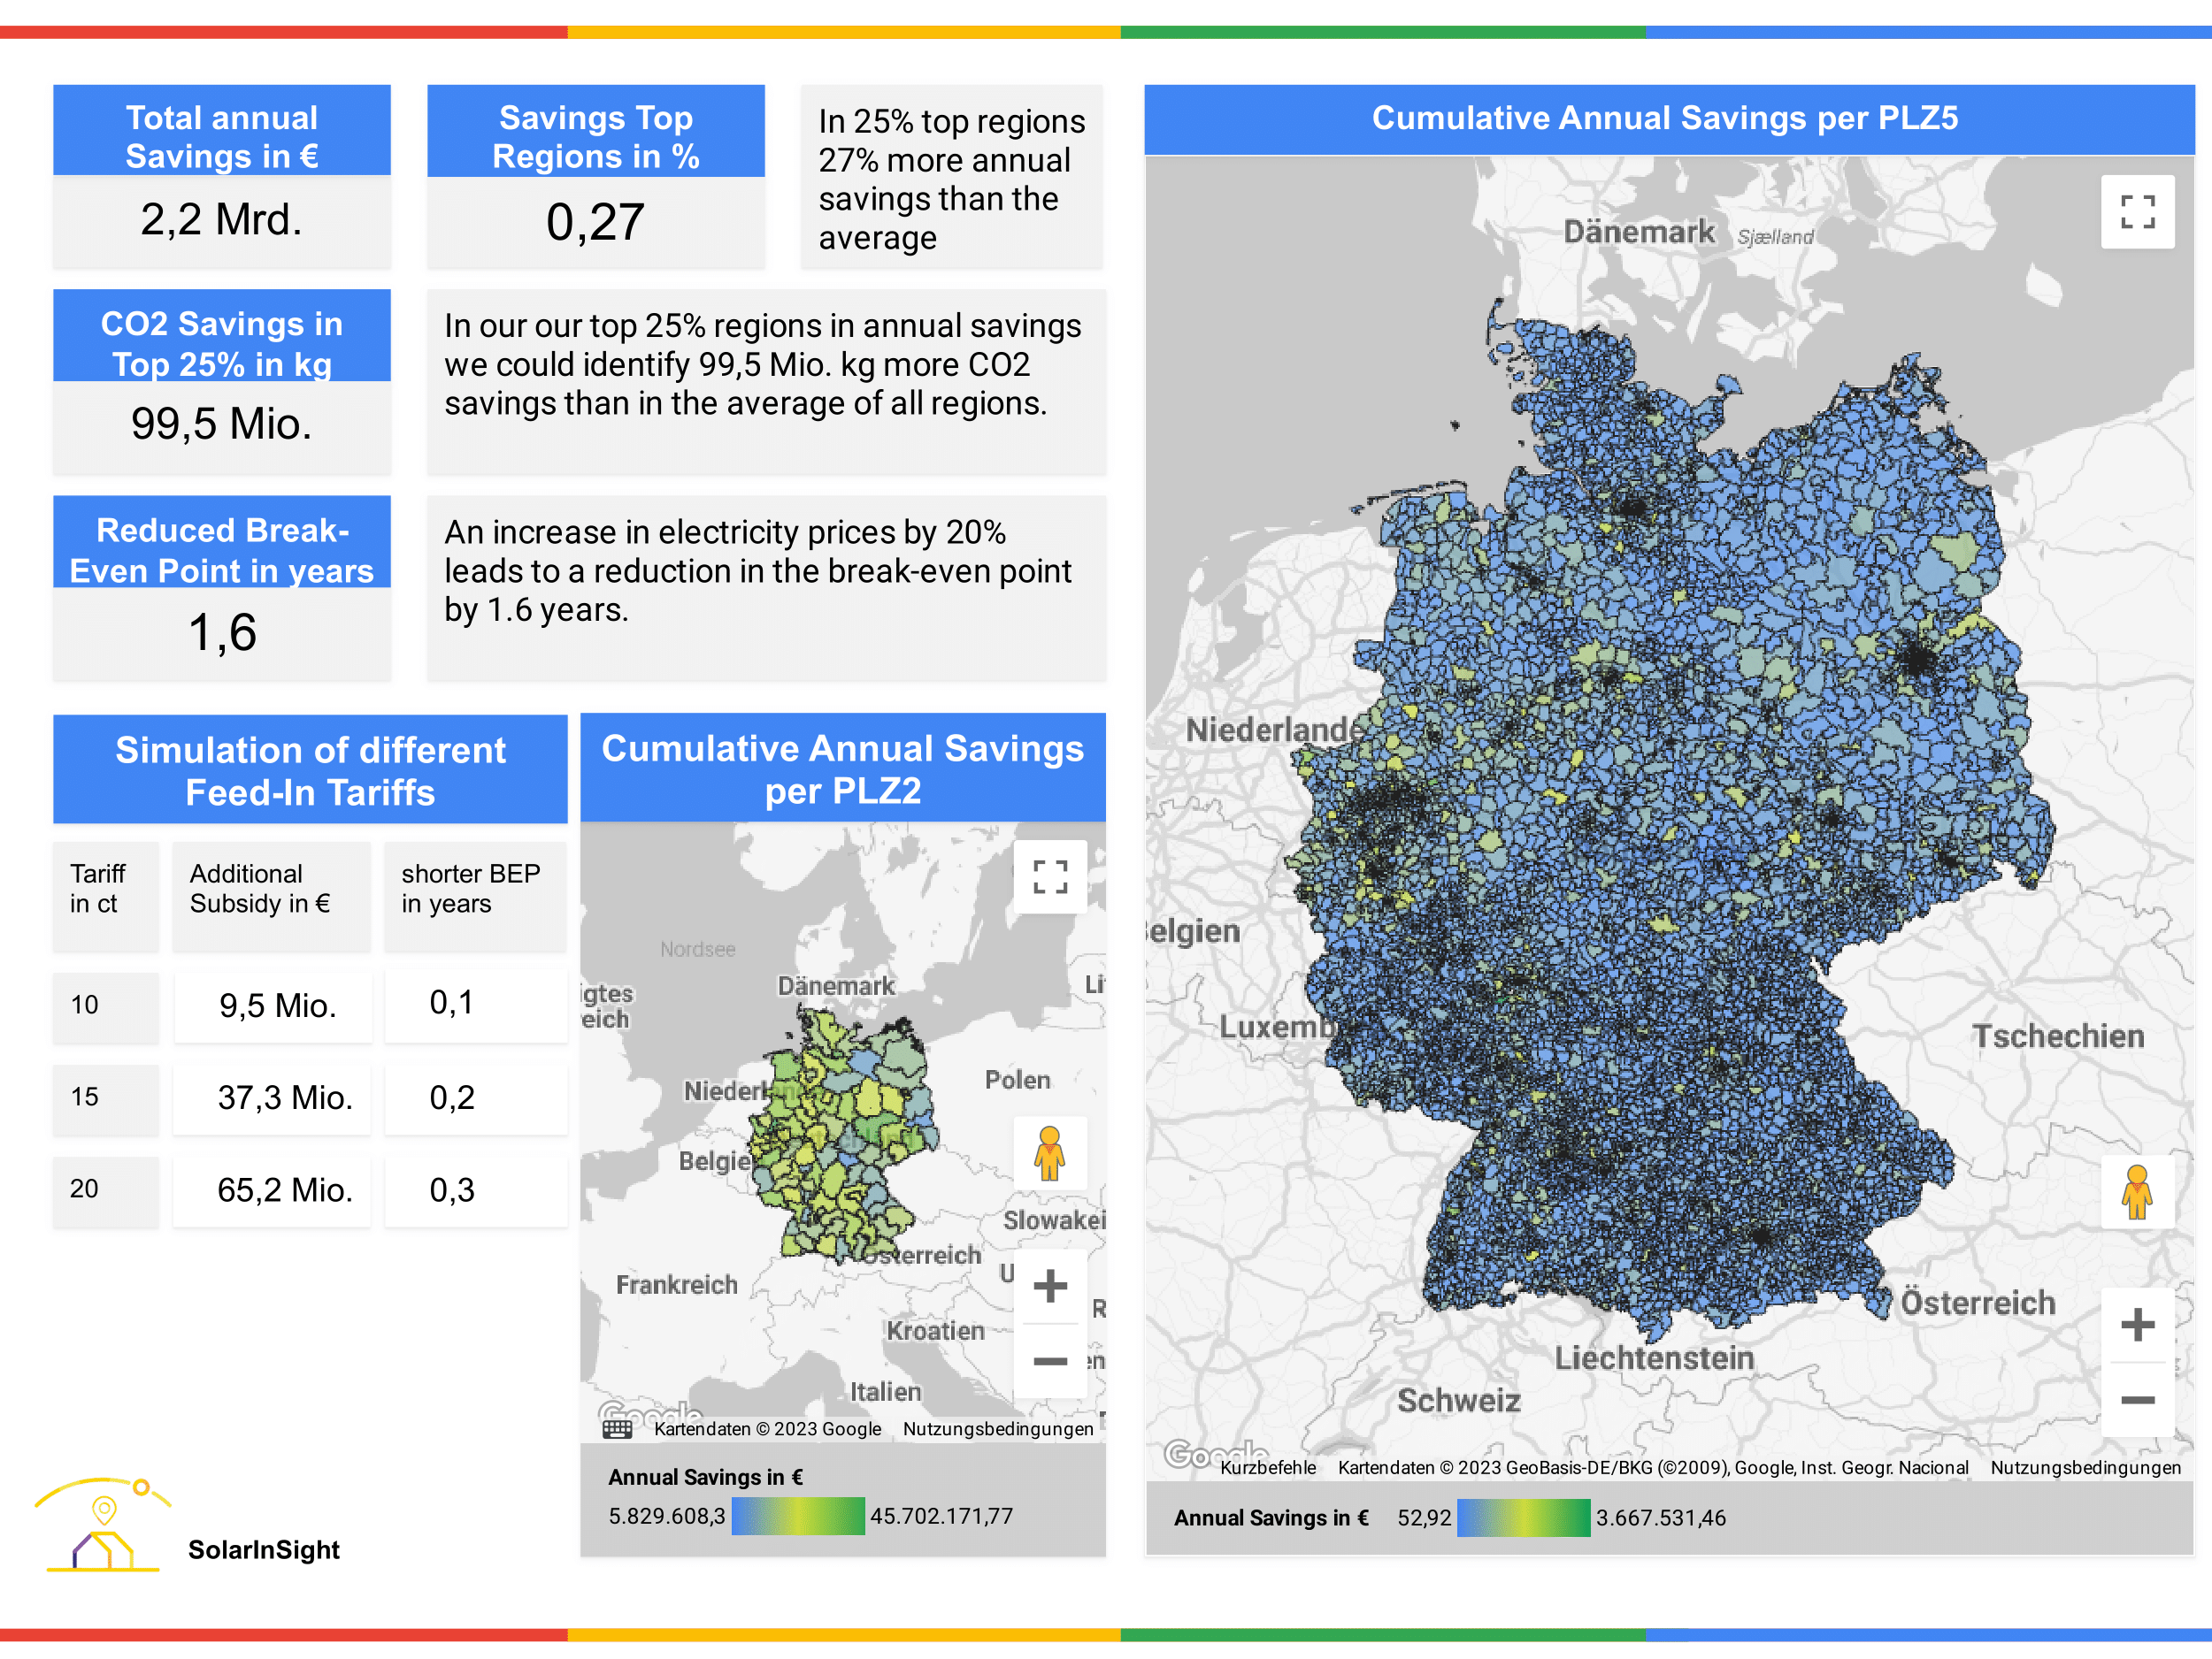

Results
We visualized our final result in an interactive dashboard with Google Looker Studio:
Maps visualizing annual savings in postal codes
KPIs:
Impact of selecting high potential regions
Impact on BEP with increased electricity price and feed-in tariffs
support data-driven decision making of stakeholders

Slide 8
We empower the german society to drive renewable energy transition via our data pipeline and insights.

Slide 9



Recommendations
Select high potential regions:
maximize potential customers and accelerate transition to renewable energy
Based on our results, we have derived these recommendations:
Evaluate potential scenarios:
e.g. electricity price and feed-in tariff increase advocate for earlier PV adoption.
Hypothetical changes in the future
Prioritize Transparency:
Allow synergy effects of different data sources, analyses and insights to accelerate.

